Slide 1
W09D1 – Time Series I
Instructor: Jeremy Eng
Credit: Eric Elmoznino

Slide 2

Introduction
Instructor: Dr. Jeremy Eng (engj@saskpolytech.ca)
Lead Cloud Applications and Data Instructor at Sask Polytech
Born and raised in Saskatoon, Saskatchewan
PhD in Statistics
Research Areas:
Big data simulations involving Monte Carlo techniques
Developing and applying machine learning techniques to model COVID-19 spread in Saskatchewan and Canada (PMCMC)
Microsoft Certified Trainer
LinkedIn: https://www.linkedin.com/in/jeremy-eng-sk/

Slide 3
Outline
Introduction
How does Time Series data differ from other data?
When can Time Series methods be used?
Time Series Analysis
Smoothing Time Series
Time Series Decomposition
Stationarity
Hypothesis Testing Review
Augmented Dickey-Fuller Test
Time Series Forecasting
ARIMA
Autocorrelation
Box-Jenkins Methodology

Slide 4
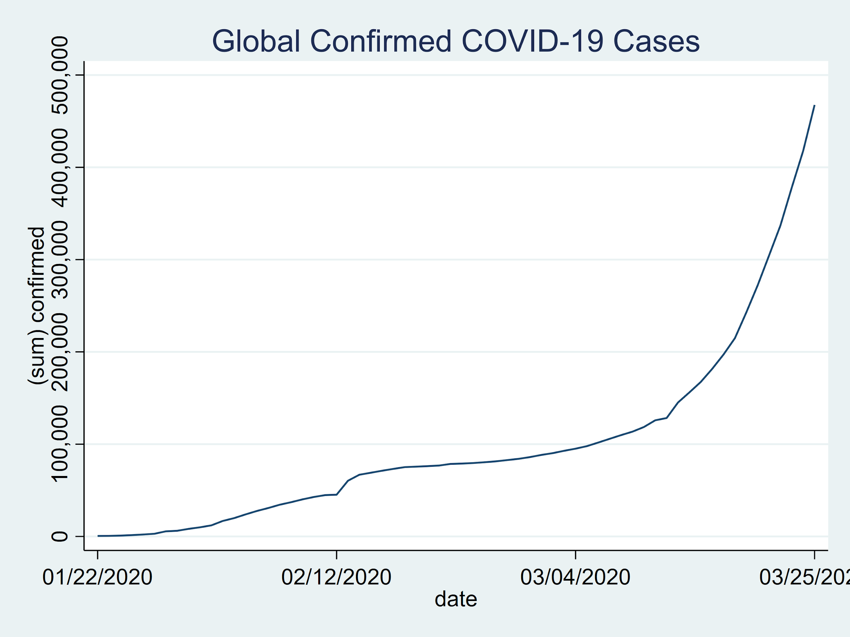
Introduction
Time-series data is ordered according to time.
Time intervals are constant (generally)
Data points are dependent
Time-series analysis
Utilizes assumption that data is received over time.
Makes future predictions
Examples:
Infection rates
Stock prices
Weather
MEG (brain activity)
Video
Notes:
Multi-dimensional: MEG and Video
We will assume univariate case

Slide 5
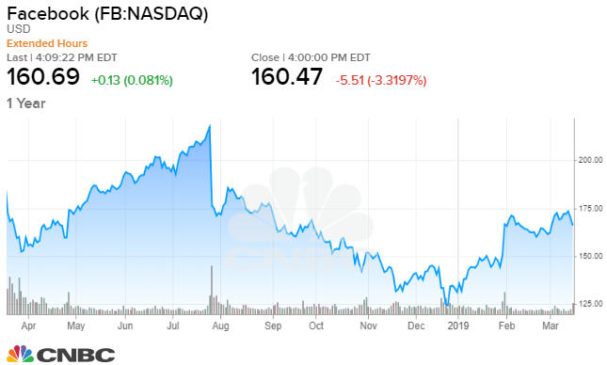
Introduction
Time-series data is ordered according to time.
Time intervals are constant (generally)
Data points are dependent
Time-series analysis
Utilizes assumption that data is received over time.
Makes future predictions
Examples:
Infection rates
Stock prices
Weather
MEG (brain activity)
Video
Notes:
Multi-dimensional: MEG and Video
We will assume univariate case

Slide 6
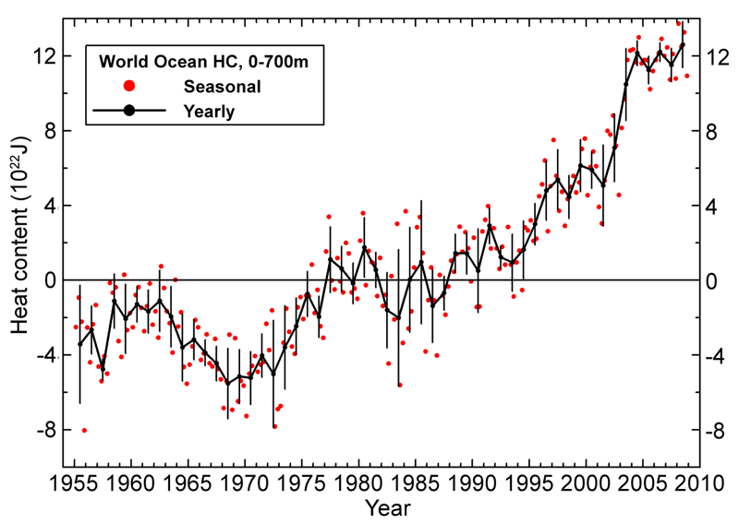
Introduction
Time-series data is ordered according to time.
Time intervals are constant (generally)
Data points are dependent
Time-series analysis
Utilizes assumption that data is received over time.
Makes future predictions
Examples:
Infection rates
Stock prices
Weather
MEG (brain activity)
Video
Notes:
Multi-dimensional: MEG and Video
We will assume univariate case

Slide 7
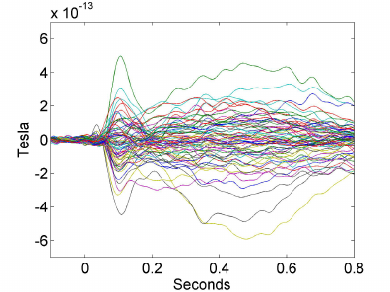
Introduction
Time-series data is ordered according to time.
Time intervals are constant (generally)
Data points are dependent
Time-series analysis
Utilizes assumption that data is received over time.
Makes future predictions
Examples:
Infection rates
Stock prices
Weather
MEG (brain activity)
Video
Notes:
Multi-dimensional: MEG and Video
We will assume univariate case

Slide 8

Introduction
Time-series data is ordered according to time.
Time intervals are constant (generally)
Data points are dependent
Time-series analysis
Utilizes assumption that data is received over time.
Makes future predictions
Examples:
Infection rates
Stock prices
Weather
MEG (brain activity)
Video
Notes:
Multi-dimensional: MEG and Video
We will assume univariate case

Slide 9
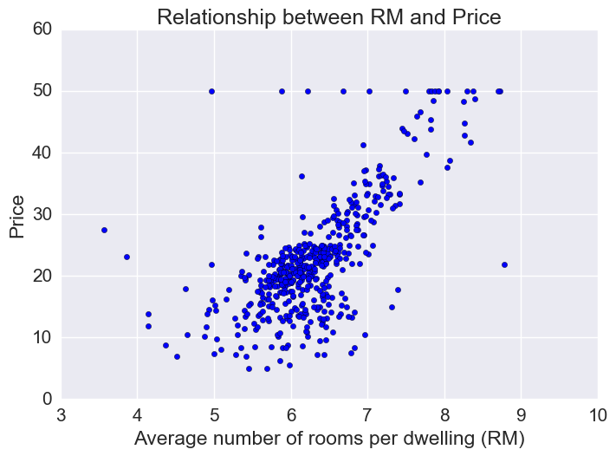
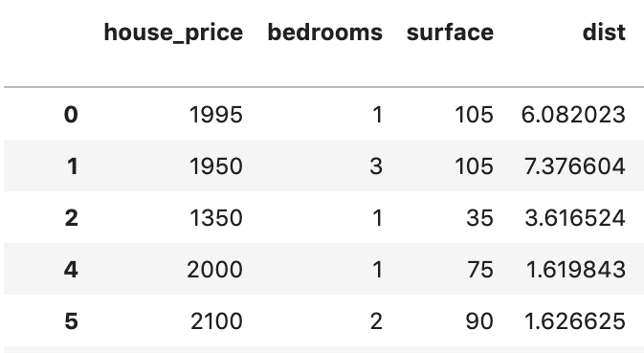
Introduction
Since the datapoints are ordered (according to time), they are no longer independent samples
Can’t shuffle rows
Breaks many model assumptions
E.g. linear regression
Time series analysis predicts FUTURE values from PAST values.
Example: house pricing

Slide 10
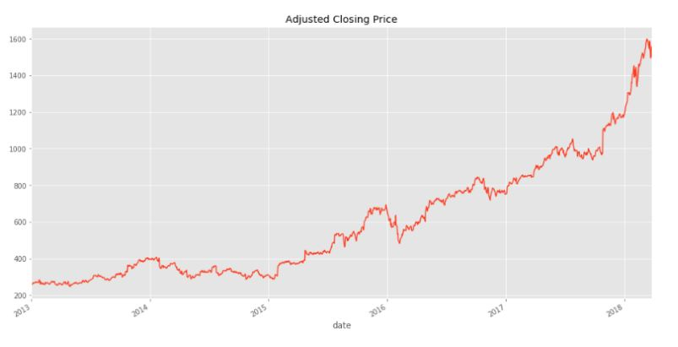
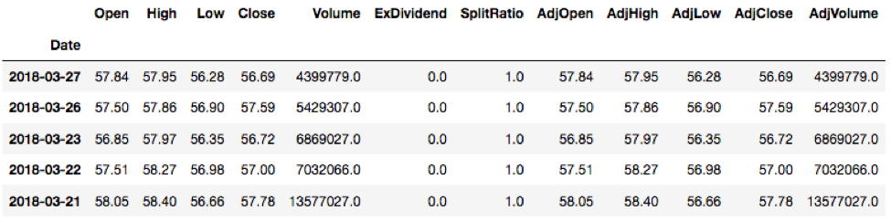
Introduction
Since the datapoints are ordered (according to time), they are no longer independent samples
Can’t shuffle rows
Breaks many model assumptions
E.g. linear regression
Time series analysis predicts FUTURE values from PAST values.
Example: house pricing

Slide 11
Introduction
Since we are predicting FUTURE values from PAST values, the dependent (target) variable is also an independent variable (feature).
Time series uses the past values of the dependent variable as independent variables.
Date (x) | Infec. (y)
2021-01-01 | 588939
2021-01-02 | 596376
2021-01-03 | 603513
2021-01-04 | 611424
2021-01-05 | 618871
2021-01-06 | 627243
2021-01-07 | 635583
2021-01-08 | 644349
2021-01-09 | 653014
2021-01-10 | 661334
t | y_{t} | x₁=y_{t-1} | x₂=y_{t-2} | x₃=y_{t-3}
0 | 588939
1 | 596376 | 588939
2 | 603513 | 596376 | 588939
3 | 611424 | 603513 | 596376 | 588939
4 | 618871 | 611424 | 603513 | 596376
5 | 627243 | 618871 | 611424 | 603513
6 | 635583 | 627243 | 618871 | 611424
7 | 644349 | 635583 | 627243 | 618871
8 | 653014 | 644349 | 635583 | 627243
9 | 661334 | 653014 | 644349 | 635583
Notes:
Can also use calculations on the past values to create other more dependent variables (e.g. average)
Can also use other dependent variables as well (season, big events, school, lockdown measures, etc.)

Slide 12
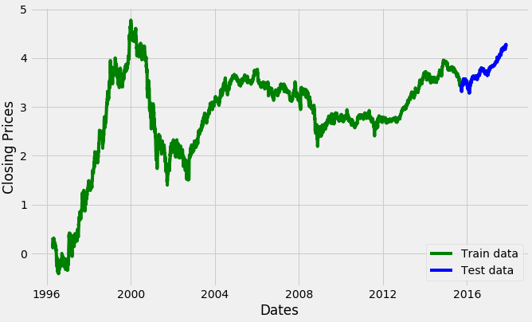
Introduction
For time series data, testing data (and predictions) come AFTER training data
Notes:
Important to re-train models as new data becomes available

Slide 13
Introduction
For time series data, testing data (and predictions) come after training data
Notes:
Important to re-train models as new data becomes available

Slide 14
Introduction
For time series data, testing data (and predictions) come after training data
Notes:
Important to re-train models as new data becomes available

Slide 15
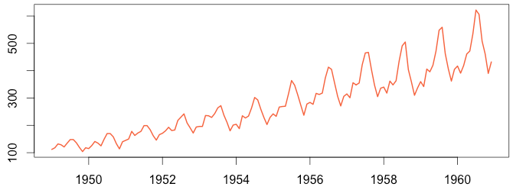
Time Series Forecasting vs Analysis
Forecasting
Predicting future values from the past
Can predict any number of time steps into the future
Most common
Analysis
Determining the properties/statistics of a time series
Autocorrelation: how long does it correlate with itself?
Trend: how is it changing over the long-term?
Seasonality: Are there repeating patterns and what are their time scales?
White noise: How much randomness is there?

Slide 16
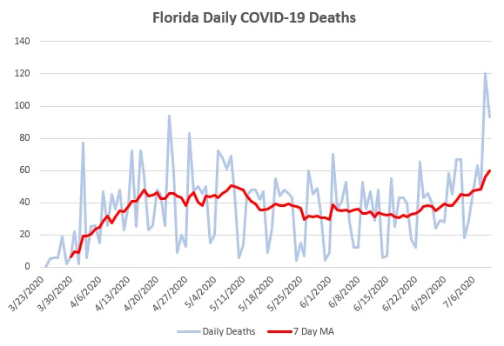
Smoothing a Time Series
Smoothing/denoising: can better see the trends by averaging out the noise
Notes:
Can use smoothing as a pre-processing technique
Can also use it for feature engineering
Ex:
y = Predict stock price
X₁ = previous stock prices
X₂ = moving average of previous 3 days

Slide 17
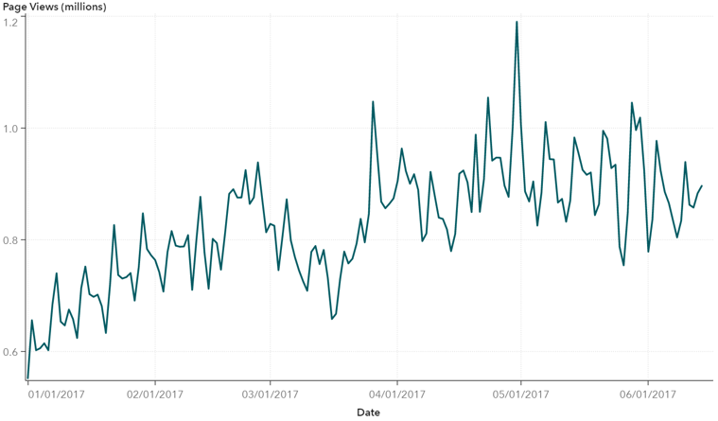
Smoothing a Time Series
Moving average:
For each time point, create a window, and calculate the average.
Window size
Mean in window
Notes:
This “moving average” smoothing technique is different than the moving average time series model.

Slide 18
Smoothing a Time Series
Moving average:
For each time point, create a window, and calculate the average.

Slide 19
Smoothing a Time Series
Moving average:
For each time point, create a window, and calculate the average.

Slide 20
Smoothing a Time Series
Moving average:
For each time point, create a window, and calculate the average.

Slide 21
Smoothing a Time Series
Moving average:
For each time point, create a window, and calculate the average.
Trailing
Centre
Notes:
Time series forecasting uses trailing moving average

Slide 22
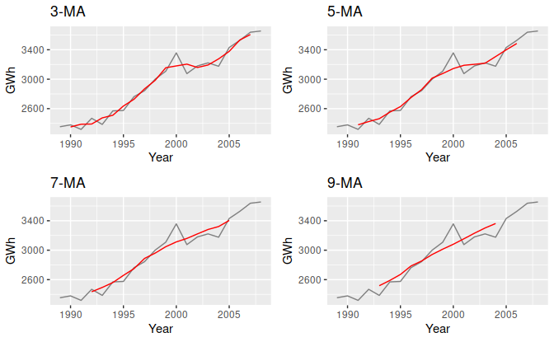
Smoothing a Time Series
Larger window size results in more smoothing.
Amount of smoothing depends on the situation.
Notes:
Day-trading vs long term investments

Slide 23
Time Series Components
What are some “components” that you notice in this time series?
Notes:
Trend
Repeating patterns (seasonality)
Noise

Slide 24
Time Series Components
Level
Trend
Seasonality
Residual
These components are combined to make a time series
Notes:
Level:
Usually not that important in modeling because we can always zero-mean the data.

Slide 25
Time Series Components
Level
Trend
Seasonality
Residual
These components are combined to make a time series
Notes:
Trend:
Long-term variations in the average value of the series.
Need not be linear.

Slide 26
Time Series Components
Level
Trend
Seasonality
Residual
These components are combined to make a time series
Notes:
Seasonality
Repeating pattern in the time series.
Can happen at any timescale.
The weather obviously has a seasonal affect at the timescale of a year, going between summer and winter. The actual seasons.
Stock prices have seasonal factors going on at the scale of days. There is a rough pattern from open to close of how the price changes, although it is a relatively weak effect.
A time series can have different seasonal effects at multiple timescales.
The weather also fluctuates over a much larger period, which is what causes ice ages and warmer periods.
Multiple trends at several timescales can make seasonality very difficult to model, especially when the seasonal effects are independent and not in phase of one another, because they all get mixed up.

Slide 27
Time Series Components
Level
Trend
Seasonality
Residual
These components are combined to make a time series
Notes:
Residual (noise)
Everything that’s left. Short-term effects, noise in the data that you can’t model, contributions from factors outside of the time series itself, or short-term correlations in the data.
For instance, if you were modeling the stock market, day-to-day rumours and emotions causing price fluctuations would not play a part in the long-term trend and wouldn’t have any seasonal pattern.

Slide 28
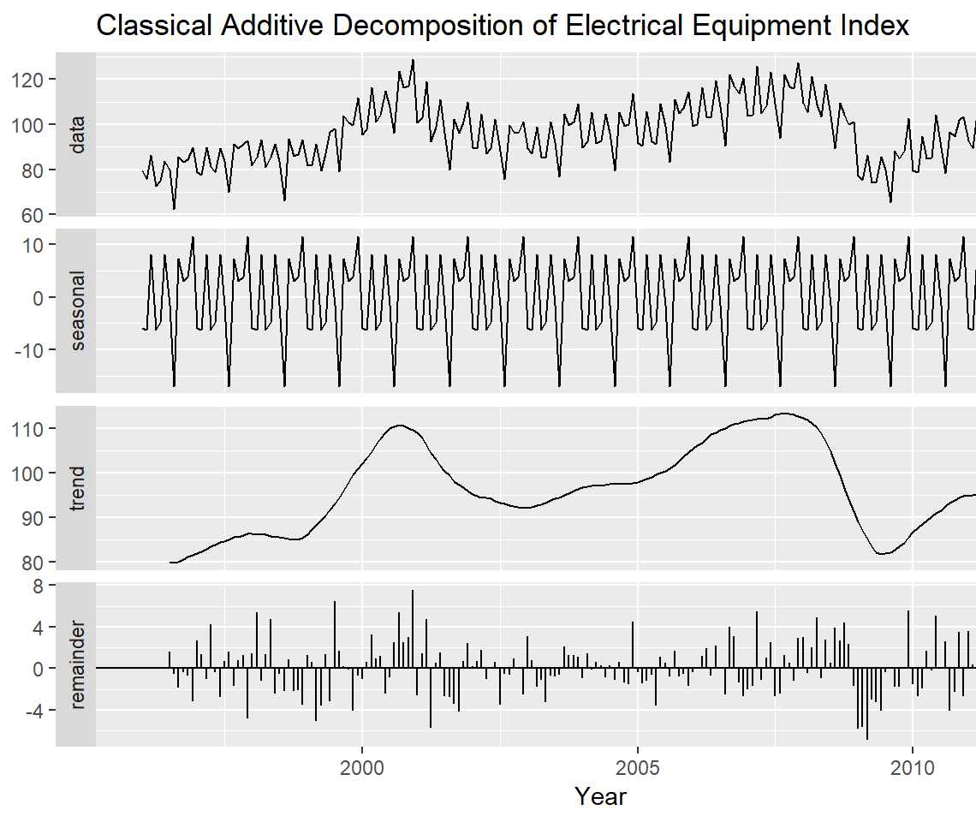
Time Series Decomposition
Additive model
y = level + trend + seasonality + residual
Most common model
Notes:
Additive:
Find trend using Moving Average, for example
Find residuals by breaking up into seasonal chunks (periods). Can then average across seasons, and difference is residuals.
Difficult in practice. Algorithms with many parameters will do this for you (and parameters can be learned).

Slide 29
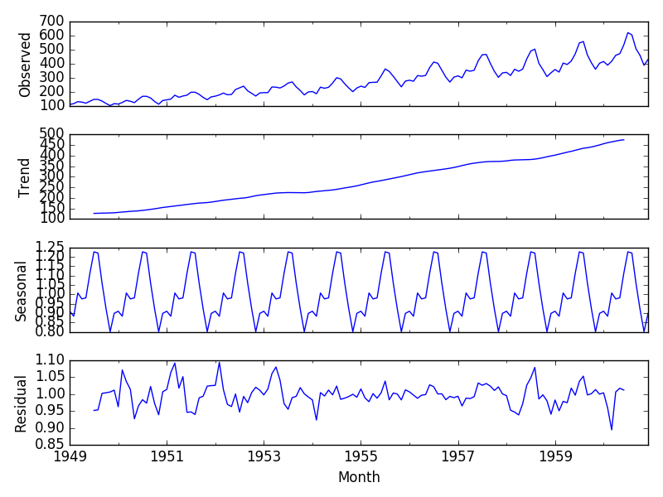
Time Series Decomposition
Additive model
y = level + trend + seasonality + residual
Most common model
Multiplicative model
y = level x trend x seasonality x residual
As trend increases/decreases, so does seasonal and residual effects.
Notes:
Multiplicative:
Typically, as trend increases (decreases), it looks like seasonal and residual effects also increase (decrease)

Slide 30
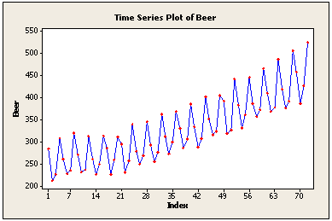
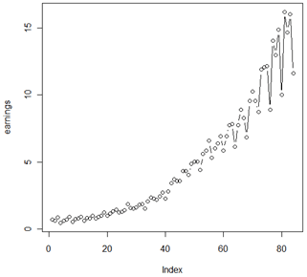
Time Series Decomposition
Additive model
y = level + trend + seasonality + residual
Most common model
Multiplicative model
y = level x trend x seasonality x residual
As trend increases/decreases, so does seasonal and residual effects.
Additive vs multiplicative

Slide 31
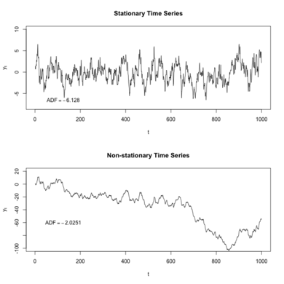
Stationarity
A time series is stationary if its statistical properties (e.g. mean, variance, dist’n) are constant over time.
Requires that there is no trend and/or seasonal component.
Problem: most classical time series models assume stationarity
AR, MA, ARMA, ARIMA
Strategies:
Check if data is stationary
If it isn’t, try to remove trend and seasonal components
Can also perform transformations (differencing, log, square root)

Slide 32
Checking for Stationarity
Look at the plot for trend/seasonality
Check for constant statistics over different time periods
Mean, variance, histogram, etc.

Slide 33

Checking for Stationarity
Look at the plot for trend/seasonality
Check for constant statistics over different time periods
Mean, variance, histogram, etc.
Hypothesis testing
More formal, less subjective than above.

Slide 34
Review: Hypothesis Testing
A statistical test used to determine if there is enough evidence to support a hypothesis
Consist of a null hypothesis (H₀) and an alternative hypothesis (H_{a} or H₁).
H₀ is the default (assumed) belief, and we are interested in if there is enough evidence overturn H₀ and instead conclude that H_{a} is true.
H₀ = not-guilty, H_{a}= guilty
H₀ = a goal was scored (ruling on the field stands), H_{a}= a goal was not scored (ruling on the field is overturned)
H₀ = data is normally distributed, H_{a}= data is not normally distributed
H₀ = time-series data is not stationary, H_{a}= time-series data is stationary
You need enough evidence to overturn H₀, since it is the default belief.
If your evidence tells you that you are “unsure”, hypothesis testing will have you stay with H₀.
You usually don’t get to “choose” what is H₀ and what is H_{a}
So how do we determine what is “enough evidence”?
P-values.
Notes:
Blue = null hypothesis
Black = data

Slide 35
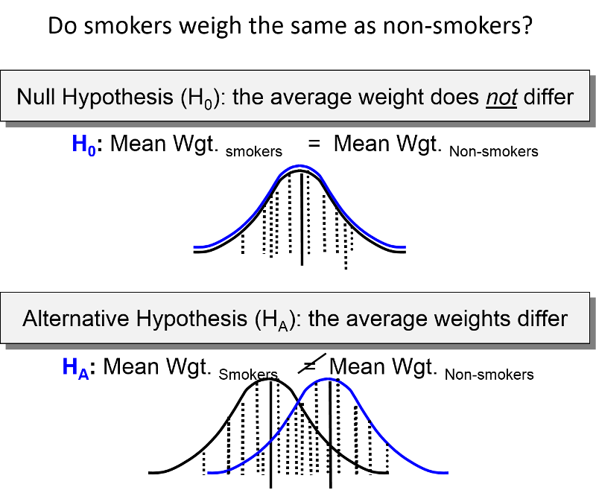
Review: Hypothesis Testing
P-value: the probability of observing the data you did (or something more extreme), assuming the null hypothesis was true.
I.e., how likely was my data, assuming the null hypothesis was true.
Layman: How likely is the null hypothesis true.
The lower the p-value, the more evidence you have to reject the null hypothesis
By convention, people reject the null hypothesis when p < 0.05.
I.e. if my null hypothesis was true, there is a less than 5% chance I would have observed my data.
If p < 0.05, reject H₀
If p ≥ 0.05, do not reject H₀
Notes:
Blue = null hypothesis
Black = data

Slide 36
Augmented Dickey-Fuller (ADF) Test
Test for stationarity
H₀: the data is non-stationary
H_{a}: the data is stationary
Input: time-series data (just the target variable)
Output: p-value = probability that the data is non-stationary (layman)
p < 0.05: strong evidence that the data is stationary (reject null hypothesis that data is non-stationary)
p >= 0.05: insufficient evidence that the data is stationary (do not reject null hypothesis)
Details omitted, explanation here.

Slide 37
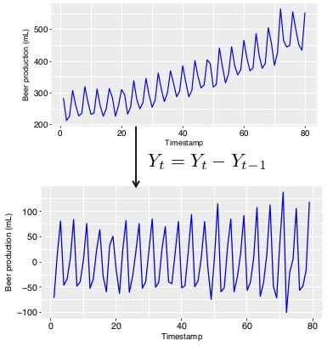
Modeling Non-Stationary Data
Differencing
Decomposition: Remove seasonality/trend
Differencing: subtracting lagged versions of the series to remove trend
I.e., Use the difference of your data.
Can do this multiple times (differencing order)
Warning: too many times can introduce artifacts
Transformations: Log or square root transformations can stabilize the variance of a time series.
Could also just use a model that can handle non-stationary data.
E.g., recurrent neural network
Notes:
Use ADF test after trying these things to again test for stationarity.

Slide 38
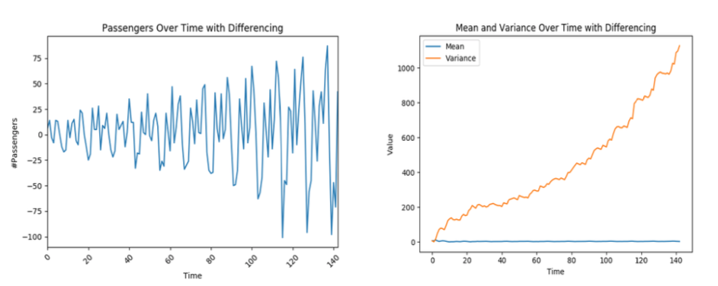
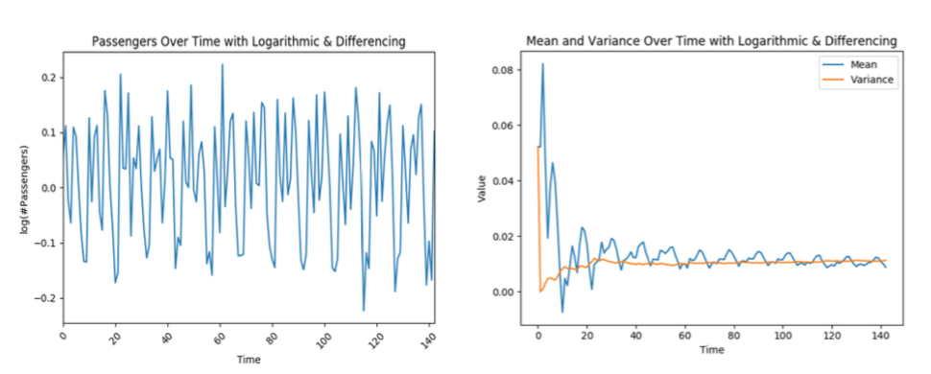
Modeling Non-Stationary Data
Transforming
Decomposition: Remove seasonality/trend
Differencing: subtracting lagged versions of the series to remove trend
I.e., Use the difference of your data.
Can do this multiple times (differencing order)
Warning: too many times can introduce artifacts
Transformations: Log or square root transformations can stabilize the variance of a time series.
Could also just use a model that can handle non-stationary data.
E.g., recurrent neural network
Notes:
Use ADF test after trying these things to again test for stationarity.
After training and making predictions on decomposed/differenced/transformed data, you will need to recompose/inverse-difference/inverse-transform back to your original domain.

Slide 39
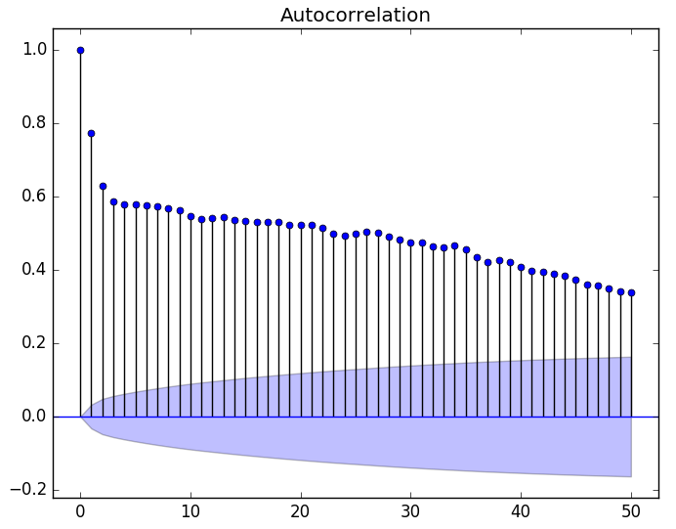
Autocorrelation
Autocorrelation: Measures how correlated a time-series is with lagged versions of itself.
“Which past time points are correlated with the present”
Notes:
Clouds at the bottom show 95% confidence intervals. If a correlation is greater than those, then we can say we are confident that correlation is real and not a fluke in the data.
Autocorrelation vs Partial Autocorrelation example:
Two effects on y_{t}
AC both paths, PAC just direct path.
Weather today vs yesterday vs two days ago
GDP for USA, CANADA, JAPAN

Slide 40
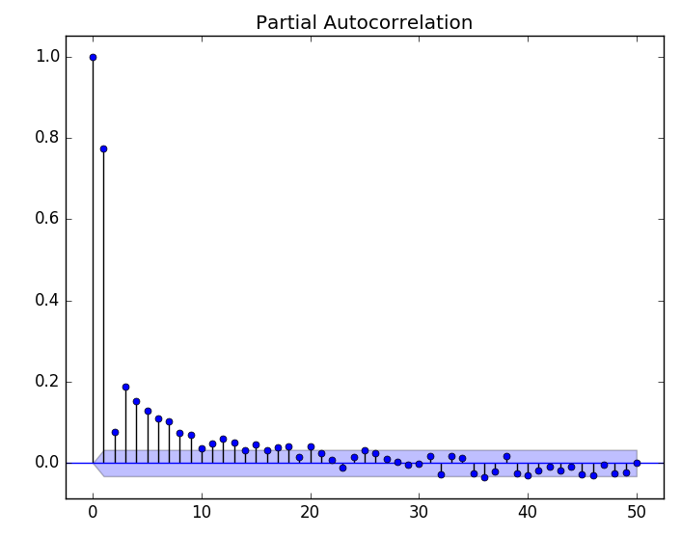
Autocorrelation
Autocorrelation: Measures how correlated a time-series is with lagged versions of itself.
“Which past time points are correlated with the present”
Partial Autocorrelation: Measures how correlated a time-series is with lagged versions of itself, unaccounted for by subsequent observations.
“Which past time points have a direct causal effect on the present”
y_{t-2}
y_{t-1}
y_{t}
Notes:
Clouds at the bottom show 95% confidence intervals. If a correlation is greater than those, then we can say we are confident that correlation is real and not a fluke in the data.
Autocorrelation vs Partial Autocorrelation example:
Two effects on y_{t}
AC both paths, PAC just direct path.
Weather today vs yesterday vs two days ago
GDP for USA, CANADA, JAPAN

Slide 41
ARIMA(p,d,q)
Autoregressive model: AR(p)
Uses observations from previous time points as input to a regression model to predict the value at the current time point.
y_{t} = c₀ + c₁y_{t-1} + c₂y_{t-2} + … + c_{p}y_{t-p}
Moving-average model: MA(q)
Uses the mean and current/previous errors to predict the value at the next time step.
y_{t} = μ + e_{t} + b₁e_{t-1} + b₂e_{t-2} + … + b_{p}e_{t-q}
Autoregressive Moving-average model: ARMA(p,q)
Contains both the AR(p) and MA(q) models
y_{t} = c₀ + c₁y_{t-1} + c₂y_{t-2} + … + c_{p}y_{t-p} + e_{t} + b₁e_{t-1} + b₂e_{t-2} + … + b_{p}e_{t-q}
Autoregressive Integrated Moving Average model: ARIMA(p,d,q)
ARMA but introduces differencing (to remove non-stationarity).
Notes:
Some simple time-series models, no longer state of the art. Neural networks have taken over.
AR: basically linear regression
MA: future values depend on the overall mean, some error, and the previous errors (residuals) (weather example)
Mention stationarity
ARMA: combination of both
We are going to dive deeper into ARIMA
Note:
AR(p) = ARIMA(p,0,0)
MA(q) = ARIMA(0,0,q)
ARMA(p,q) = ARIMA(p,0,q)

Slide 42
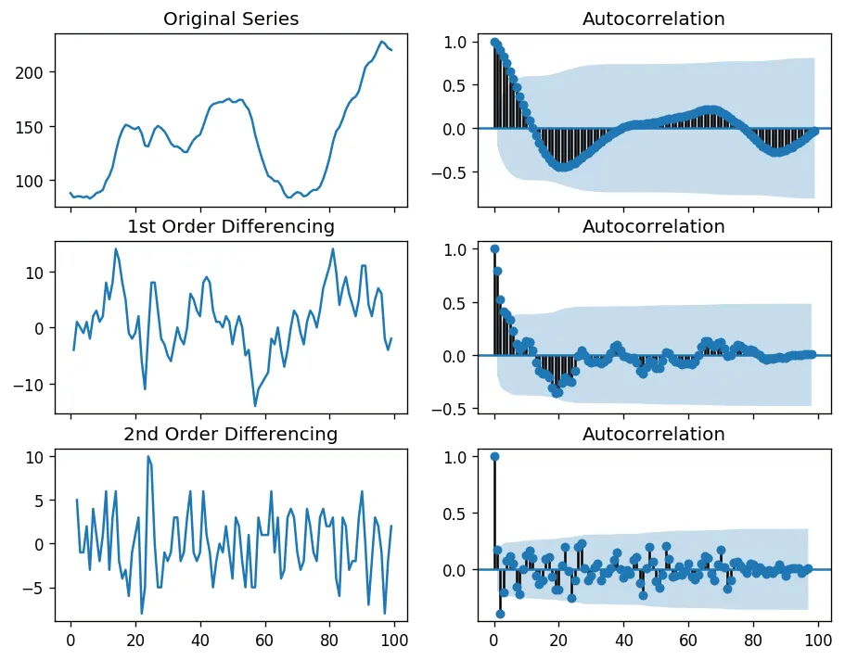
ARIMA(p,d,q)
Integrate (d)
Integrate just means to apply differencing.
In ARIMA models, the first step is to “integrate” d times.
d is a hyperparameter
Want our time series to be stationary.
Can use the ADF test to help

Slide 43
ARIMA(p,d,q)
Autoregression (p)
Uses observations from the previous d time points as input to a regression model.
y_{t} = c₀ + c₁y_{t-1} + c₂y_{t-2} + … + c_{p}y_{t-p}
Partial autocorrelation plot can inform the choice of p.

Slide 44
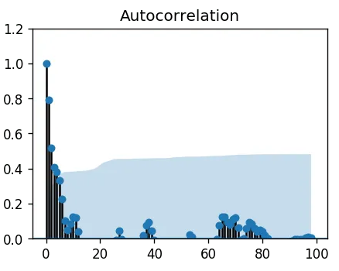
ARIMA(p,d,q)
Moving Average (q)
Uses the mean and current/previous errors to predict the value at the next time step.
y_{t} = μ + e_{t} + b₁e_{t-1} + b₂e_{t-2} + … + b_{p}e_{t-q}
Car production vs demand example:
Last year:
Predict: 1000 sales
Demand: 1200 sales
Error: 200 sales
This year:
Predict: 1000 + b₁(error)
Autocorrelation plot can inform the choice of q.
See here for more details.

Slide 45
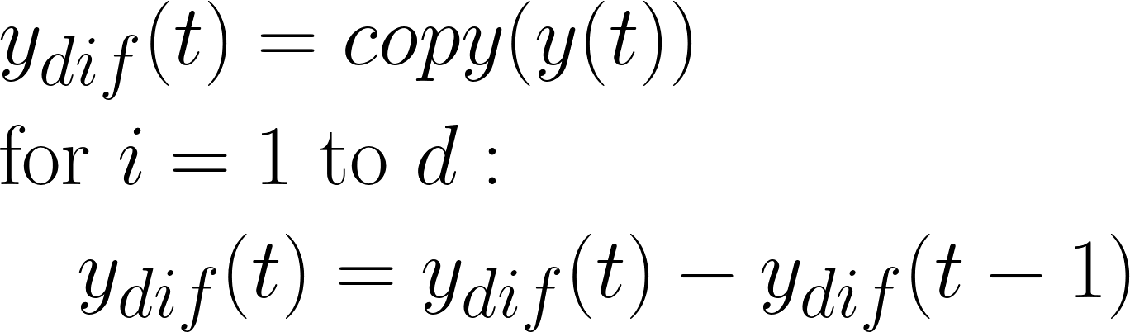
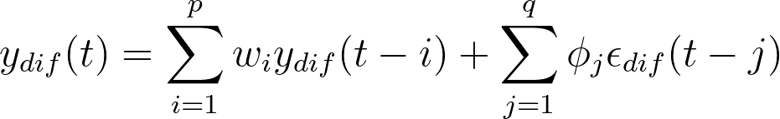
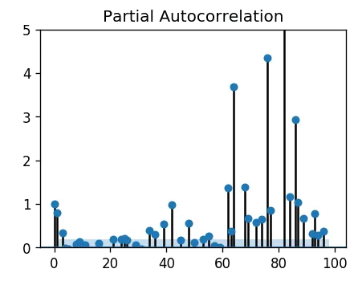
ARIMA(p,d,q) Summary
d
p
q
Pick hyperparameters d, p, and q

Slide 46
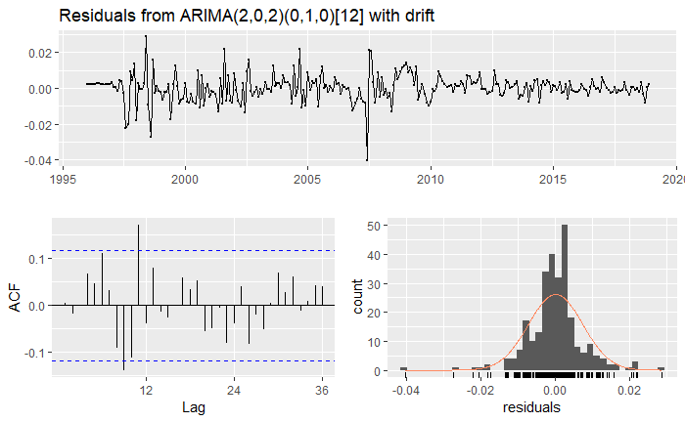
Box-Jenkins Methodology
Iterative 3-step approach to modeling time series
Assumption: time series can be modeled using an ARIMA model
Identification: use data and its statistics to select model hyperparameters
Pick ARIMA p, d, q
Estimation: use data to train the parameters (i.e. weights) of the model
Fit ARIMA on training data
Diagnostic checking: evaluate model residuals (errors) and overfitting
Check over-fitting (predict future values not in training data)
Residuals (errors) should have no structure (random) after modeling

Slide 47
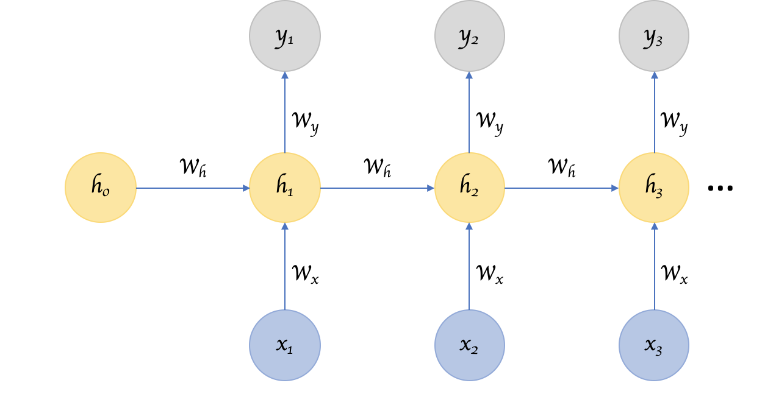
Recurrent Neural Networks
RNN’s can handle non-stationary time series
Observe data (x_{t}) sequentially.
Memory state (vector h_{t}) is updated with each observation.
Components contain trend, seasonality, short-term etc. info. These are learned.
Can read out future predictions (y_{t}) from the memory state.
State of the art.
More info here
Notes:
ARIMA struggles with complex patterns and forecasting far into the future
RNNs are good with sequence data (audio, text, time-series)
Vanishing (exploding) gradient problem
LSTM/GRU (long-short term memory, gated recurrent unit)
More recently: transformers. Better performance and can utilize parallel programming.

